Slide 1
Comprehensive digital marketing project work
Company : LOUIS PHILLIPE

Slide 2
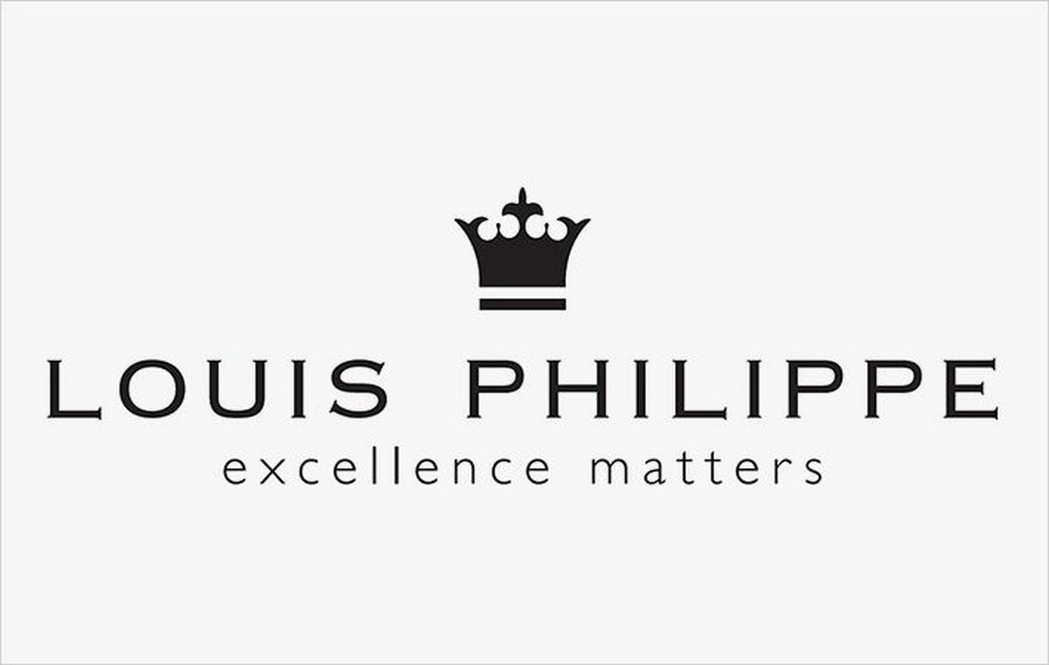
BRAND LOGO :

Slide 3
Part 1: Brand study, Competitor Analysis & Buyer’s/Audience’s Persona
Research Brand Identity: Study the brand's mission, values, vision, and unique selling propositions (USPs).
MISSION : To deliver superior value to our customers, shareholders, employees and society at large.
VISSION : To passionately satisfy Indian consumer needs in fashion, style and value, across wearing occasions in Apparel and Accessories through strong brands and high-quality consumer experience with the ultimate purpose of delivering superior value to all our stakeholders.

Slide 4
Part 1: Brand study, Competitor Analysis & Buyer’s/Audience’s Persona
VALUES :
Seamlessness.
Passion.
Speed.
Commitment.
Integrity.
UNIQUE SELLING PROPOSTIONS : Symbolizes elegance, Class, Status, and a life style that is distinctly majestic and opulent.
Analyze brand messaging : The brand symbolizes of being "Achieved".
Examine the brand tagline : The Upper Crest.

Slide 5
Part 1: Brand study, Competitor Analysis & Buyer’s/Audience’s Persona
Competitor Analysis : Select three competitors operating in the same industry or niche as the chosen brand, examine their USPs and online communication.
Competitor 1 : Myntra is a online shopping site for fashion & lifestyle in india. India's fashion expert brings you a variety of footwear, clothing, accessories and lifestyle products for women & men.
Competitor 2 : AJIO is a online shopping for women, men, kids – clothing, footwear.
Competitor 3 : Adidas AG is a German athletic apparel and footwear corporation headquartered in Herzogenaurach, Bavaria, Germany. It is the largest sportswear manufacturer in Europe, and the second largest in the world, after Nike.

Slide 6
Part 1: Brand study, Competitor Analysis & Buyer’s/Audience’s Persona
Buyer’s/ Audience’s Personal info : Louis Philippe is a Luxury Indian brand of men's apparel. It is a brand of Madura Fashion & Lifestyle, a division of the Aditya Birla Group. It is one of the largest apparel brands in India as of 2018. The Label is an online fashion and lifestyle magazine for men by Louis Philippe.
Demographics :
62% - 20 to 30 years, 28% - 30 to 40 years, 10% - 40 and above.
93% Males & 7% Females.
48% users recollect showroom displays, 17% recollect ads
35% International brand image.
65% consider it sophisticated, luxurious and status symbol.
60% people were either IT professionals or in finance.
20% students from the buyer segment.
Around 50% buys formals & 40% buys casuals & shoes.

Slide 7
Part 1: Brand study, Competitor Analysis & Buyer’s/Audience’s Persona
Psychographics :Brand can be seen by a customer as a kind of person the user wishes to be. A user may not wish to be the brand but have a liking or admiration towards such a person.
Behaviours : The marketers try to understand the actions of the consumers in the market place and the underlying motives such actions. These motives are the factors that influence the consumer behavior.
Some of them are :
Psychological factors.
Motivation.
Perception.
Learning.
Attitudes and beliefs.

Slide 8
Part 1: Brand study, Competitor Analysis & Buyer’s/Audience’s Persona
Cultural factors : It is believed that an individual learns the set of values, perceptions, behaviors, and preferences at a very early stage of his childhood from the people especially, the family and the other key institutions which were around during his developmental stage. Thus, the behavioral patterns are developed from the culture where he or she is brought up. Several cultural factors are:
Culture.
Subculture.
Social class.

Slide 9
Part 2: SEO & Keyword Research
SEO AUDIT : LouisPhillipe.com Audience Interests
Audience interests reveal key details on the browsing interests of Louisphillipe.com visitors. Louisphillipe.com audience is interested in Computers Electronics and Technology.
Social Media Networks & community.
Audience composition can reveal a site's current market share across various audiences. Louisphillipe.com audience is 93% male and 7% female.
On-Page Optimization : Optimizing the on-page elements of the louis Philippe website can greatly improve its search engine visibility and user experience. Hence are some on-page optimization tips specific to Louis Philippe: Keyword Research, Meta Tags, Content optimization, Product Descriptions, URL Structures, Image Optimization, Internal Linking, Mobile Optimization, Schema Markup, User Experience.
By implementing these on-page optimization techniques, Louis Philippe's website can improve its search engine rankings, attract more organic traffic, and provide a better overall experience for its visitors. Remember to regularly monitor and update the site as SEO best practices evolve.

Slide 10
Part 2: SEO & Keyword Research
Keyword Research : Identify relevant keywords related to Louis Philippe's products, such as men's clothing, formal wear, accessories, etc. Use tools to find high-volume and low-competition keywords.
Meta tags : Optimize meta titles and descriptions for each page, incorporating the targeted keywords naturally and appealingly to encourage users to click through from search results.
Page Speed : Optimize page loading times by compressing images, leveraging browser caching, and minimizing unnecessary scripts.
URL Structures : Use descriptive and keyword-rich URLs for each page, making it easier for search engines to understand the content.

Slide 11
Part 3: Content Ideas and Marketing Strategies
Marketing Strategies : Marketing Strategy of Louis Philippe analyzes the brand with the marketing mix framework which covers the 4Ps (Product, Price, Place, Promotion). These business strategies, based on Louis Philippe marketing mix, help the brand succeed in the market.
Product Strategy : Louis Philippe is one of the most popular apparel brand based out of India, specializing in formal clothing. The brand has a wide portfolio in its marketing mix product offering, ranging from shirts, trousers, accessories etc. Louis Philippe covers a range of formals, semi-formals, custom-made clothing, accessories and footwear.
Pricing Strategy : Louis Philippe used high quality Cotton from the best of sources. Not only this, but the perfection and comfort of the clothing are evident from the exquisite range of their innerwear which is made from the softest cotton and their shoes which are made from the best quality leather.

Slide 12
Part 3: Content Ideas and Marketing Strategies
Place & Distribution Strategy : Louis Philippe reaches its customers through a large network comprising of many exclusive and franchise stores, and premium multi-brand trade outlets, both outside and inside India. It wants to open 15 large format stores, each store size will be 5000 sq. ft. Apart from the large format stores, the brand currently has over 120 stores across India, and plans to add about 40 new stores every year.
Promotion & Advertising Strategy : Louis Philippe was originally positioned as a brand for the youth. However, with the introduction of its sub-brand “Crest”, it no longer remains a brand for the youth but a well-accepted brand by all the segments of customers and it wants itself to be perceived as a “winner”. The brand symbolizes of being "Achieved". Very rarely brands attain this kind of status. The brand recently has associated itself with games such as golf and thereby tries to establish connection and an emotional relationship with the segment of target audience which values perfection and quality.

Slide 13
Part 4: Content Creation and Curation (Post creations, Designs/Video Editing, Ad Campaigns over Social M
Post Creation :
Select Content Categories : Identify three different content formats relevant to the chosen topic or industry. Research and Brainstorm: Research trending topics, industry news, or audience interests within each category. Brainstorm ideas for social media posts that align with each category. Do note that 1 content format has to be video and additionally 3 stories/status are to be created.
Format 1
Format 2
Format 3

Slide 14
Format 1 :
Louis Philippe is a premium brand of men's apparel originating from India. It is a subsidiary of Madura Fashion & Lifestyle. It is division of the Indian Conglomerate Aditya Birla Group, and was founded in 1989.
Louis Philippe follows Prestige Pricing Strategy-also called image pricing or premium pricing- to retain their market leadership. It's a strategy that can be used efficiently when there is uniqueness about the product or when the product has a distinct offering.

Slide 15
Format 2 :

Slide 16
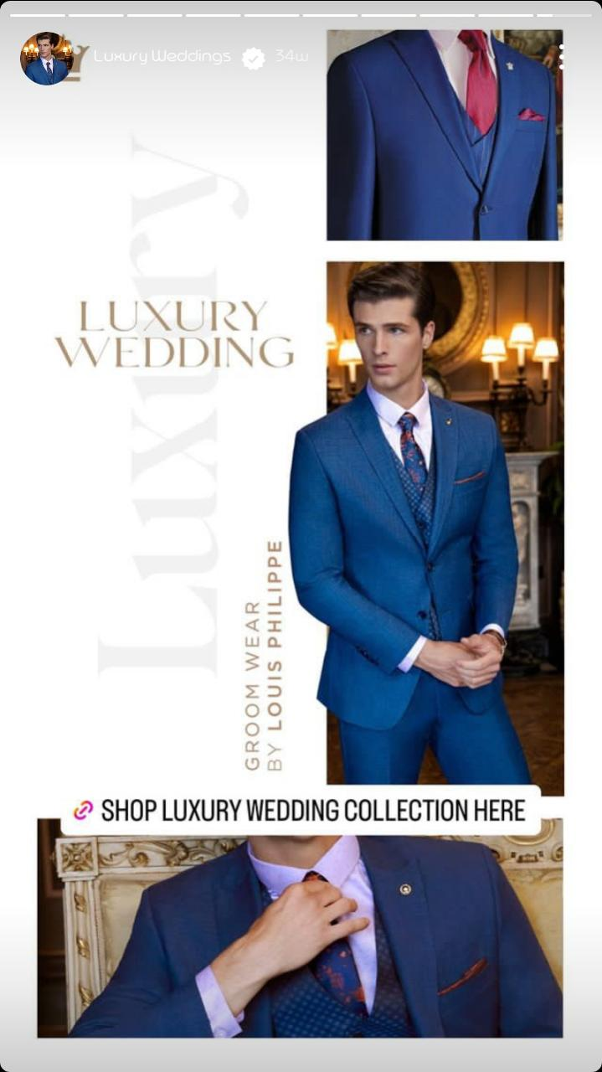
Part 4: Content Creation and Curation (Post creations, Designs/Video Editing, Ad Campaigns over Social Media and Email Ideation and Creation)
INSTAGRAM STORY :

Slide 17
Part 4: Content Creation and Curation (Post creations, Designs/Video Editing, Ad Campaigns over Social Media and Email Ideation and Creation)
Designs/Video Editing
Design Tools Familiarization (use Canva for creating visually appealing graphics)
Video Creation : Utilize VN or any video editor of your choice to create videos related to the chosen topic.
VIDEO LINK :

Slide 18
Part 4: Content Creation and Curation (Post creations, Designs/Video Editing, Ad Campaigns over Social Media and Email Ideation and Creation)
Social Media Ad Campaigns
Ad Campaigns over Social Media:
Come up with 3 ad campaigns each covering one of the mentioned goals: brand awareness, driving website traffic, or generating leads.

Slide 19
Part 4: Content Creation and Curation (Post creations, Designs/Video Editing, Ad Campaigns over Social Media and Email Ideation and Creation)
For every campaign clearly define:
Advertising Goals: Increasing brand awareness, driving website traffic, or generating leads.
Audience Targeting : Define the target audience for the ad campaigns based on demographics, interests, and behavior.
Ad Creation : Create visually appealing ad Creatives, compelling ad copy and relevant call-to-action.

Slide 20
Part 4: Content Creation and Curation (Post creations, Designs/Video Editing, Ad Campaigns over Social Media and Email Ideation and Creation)
Email Ad Campaigns
Ad Campaigns for email marketing :
Come up with 2 email ad campaigns with the mentioned goals: brand awareness & generating leads

Slide 21
Email Ad Campaign 1 - Brand Awareness
(insert emailer image)

Slide 22
Email Ad Campaign 2 - Lead Generation
(Insert E-mailer image)

Slide 23
Part 4: Content Creation and Curation (Post creations, Designs/Video
Editing, Ad Campaigns over Social Media and Email Ideation and Creation)
Reflect on the content creation and curation process, discussing the challenges faced and lessons learned.

